Slide 1
Instructor readiness test
Candidate Support

Slide 2
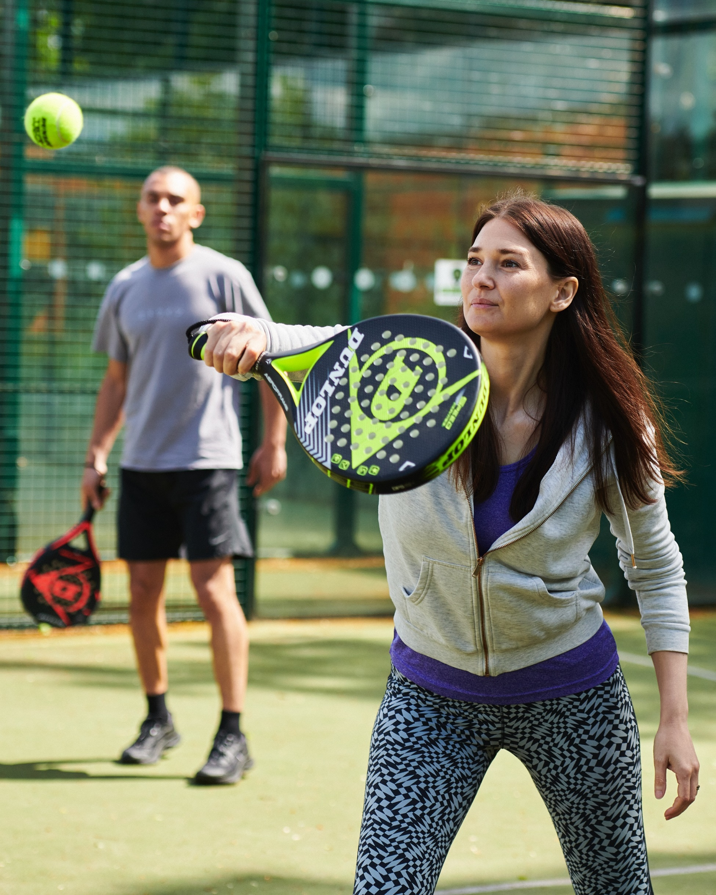
overview
Given how new padel is in Britain, this resource is designed to support prospective Padel Instructors undertake their Padel Instructor Readiness Test.
Each section outlines the requirements of one of the tasks, and, where applicable, details some tactical and technical areas to develop coaches’ knowledge and skills.
To access the video for the task please click the video hyperlink in the title of each page.

Slide 3
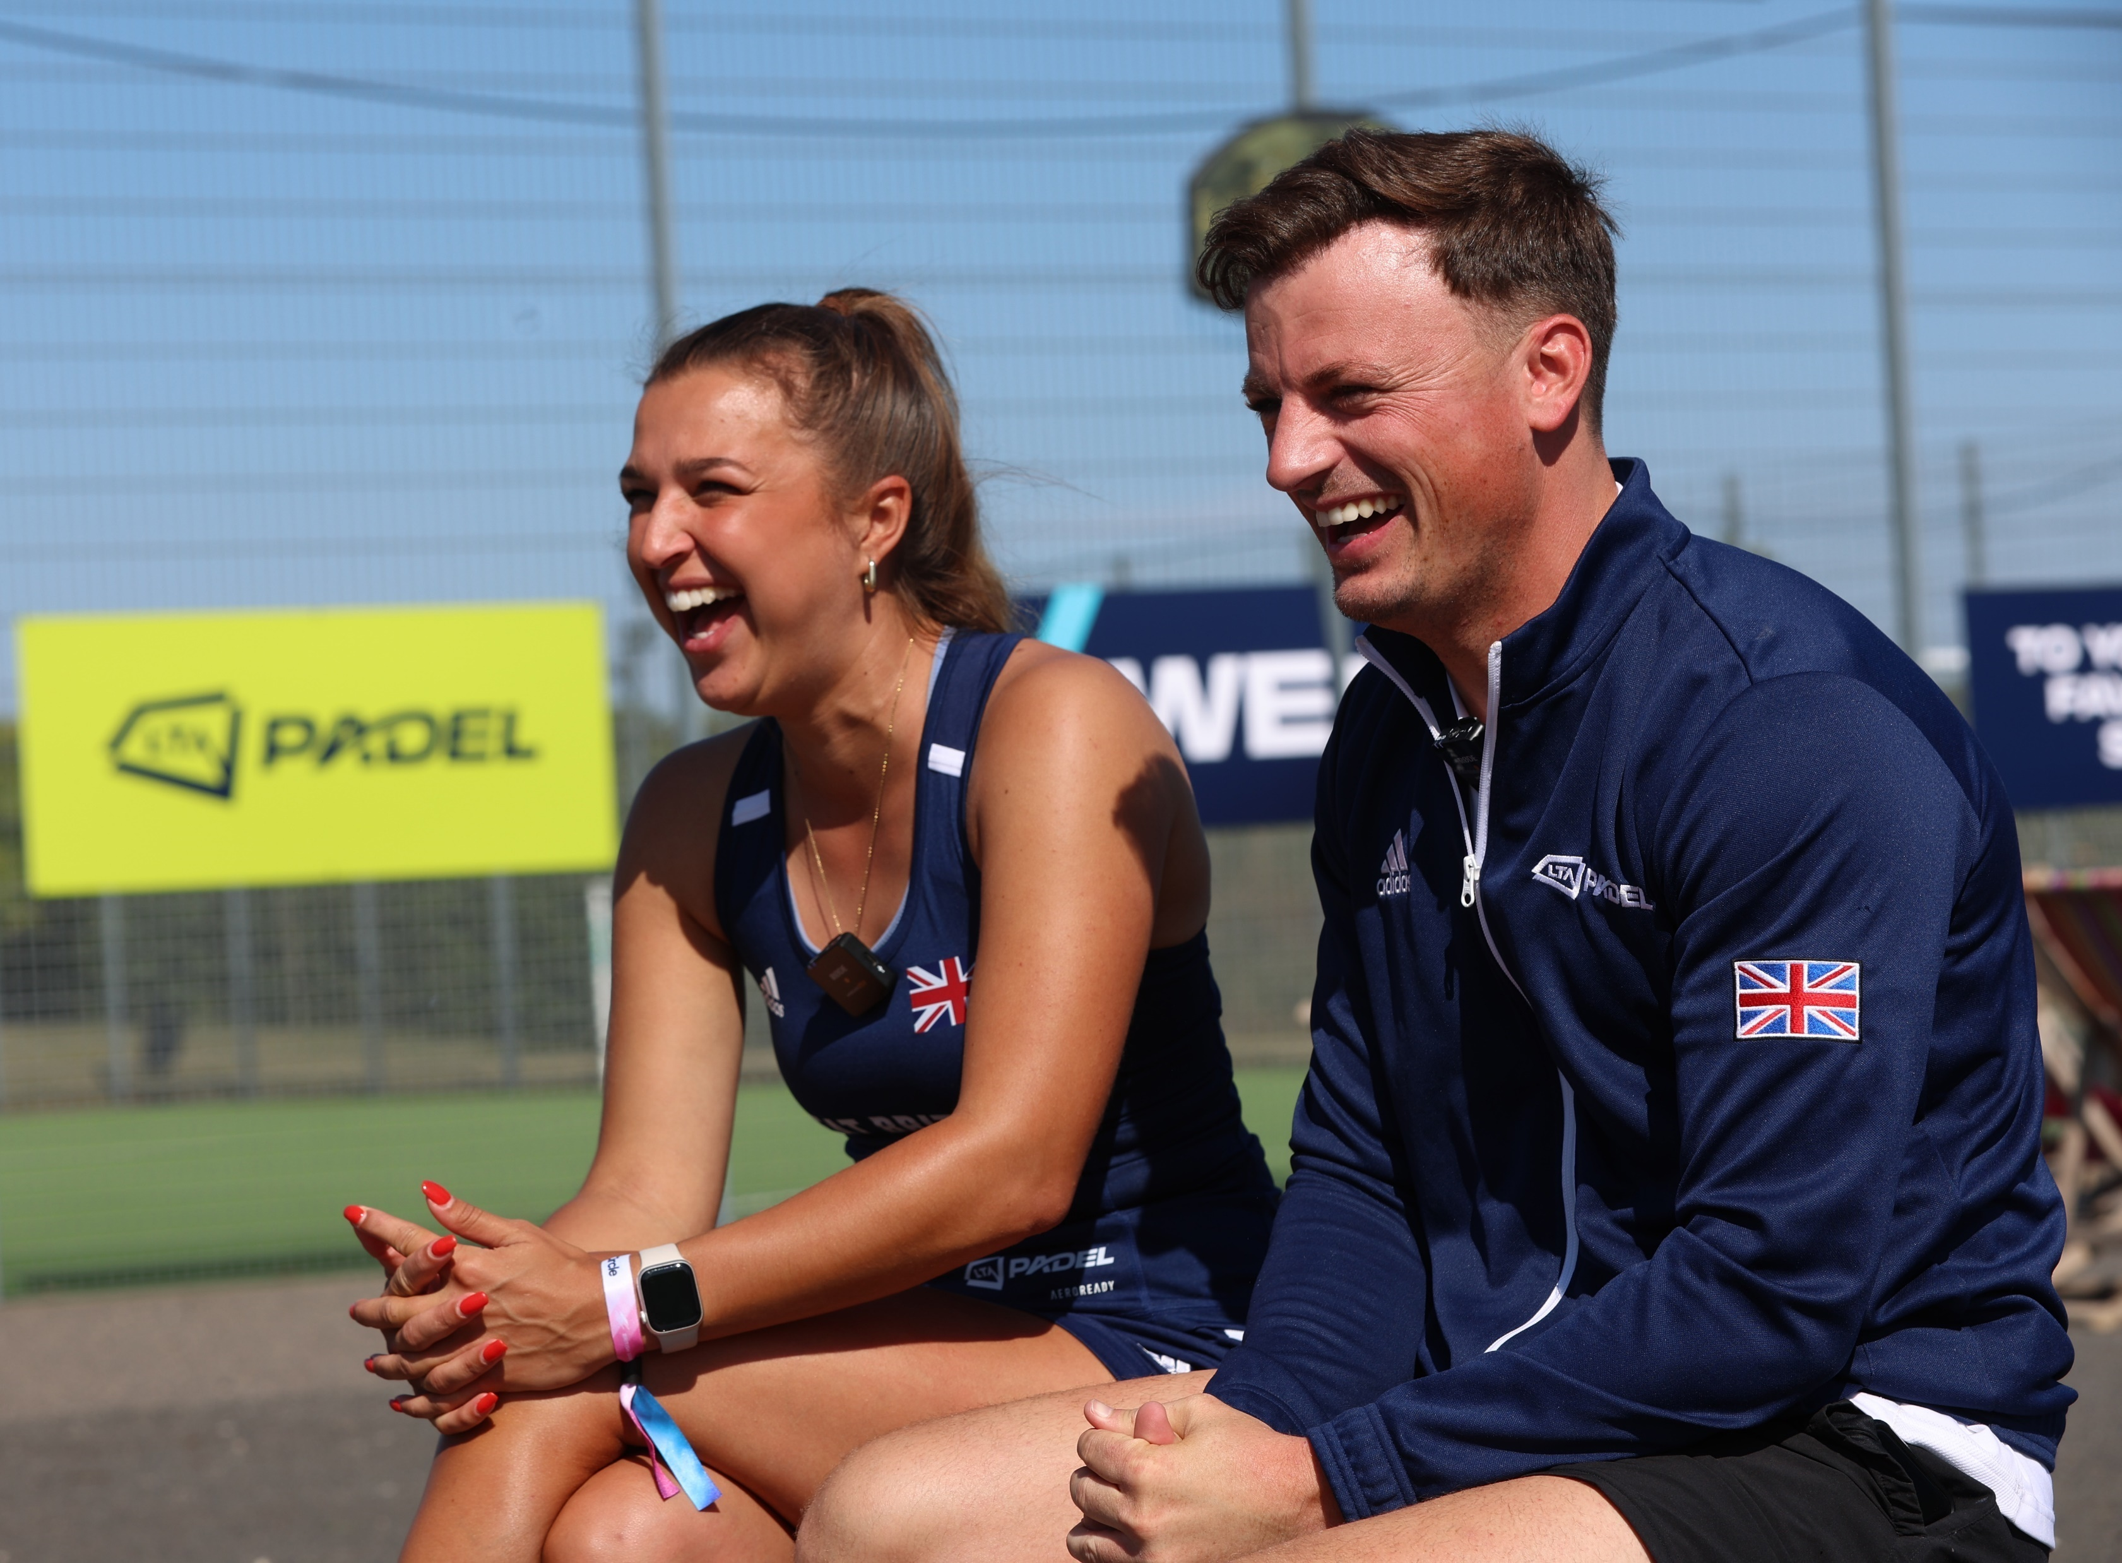
Table of contents
Why do we need a Readiness Test?
Readiness Test Tasks
Personal Statement
Demonstration Task
Lob Feeding Task
Serve Task
Volley Task
Groundstrokes Task

Slide 4
Why do we need a readiness test?
The Padel Instructor qualification is a rigorous and demanding course for anyone looking to pursue a career coaching padel.
The Readiness Test is designed with two core purposes:
To enable coaches to understand if they are ready for the demands of the course
To protect the course curriculum by ensuring all learners have a minimum foundation of knowledge and skills on which the qualification can build
The videos in your submission will show that you have sufficient padel skills and knowledge required for the Padel Instructor course and your subsequent coaching career.
NB It is important to note that your submission will be assessed against both the outcome criteria AND your ability to demonstrate sound padel technique.
When you book a Padel Instructor Readiness Test, comprehensive guidance and support are available on LTA Learn.

Slide 5
Readiness test tasks
You will need to complete the following videos to complete your readiness test. These videos will then be submitted on to LTA Learn.
Video submission | What is assessed
Personal statement | Communication skills and padel knowledge
Demonstration task | Communication skills, padel skills, padel knowledge
Lob feeding task | Feeding skills
Groundstroke task | Live ball feeding skills, role modeling accurate padel technique,
Volley task | Live ball feeding skills, role modeling accurate padel technique,
Serve task | Feeding skills, role modeling accurate padel technique

Slide 6
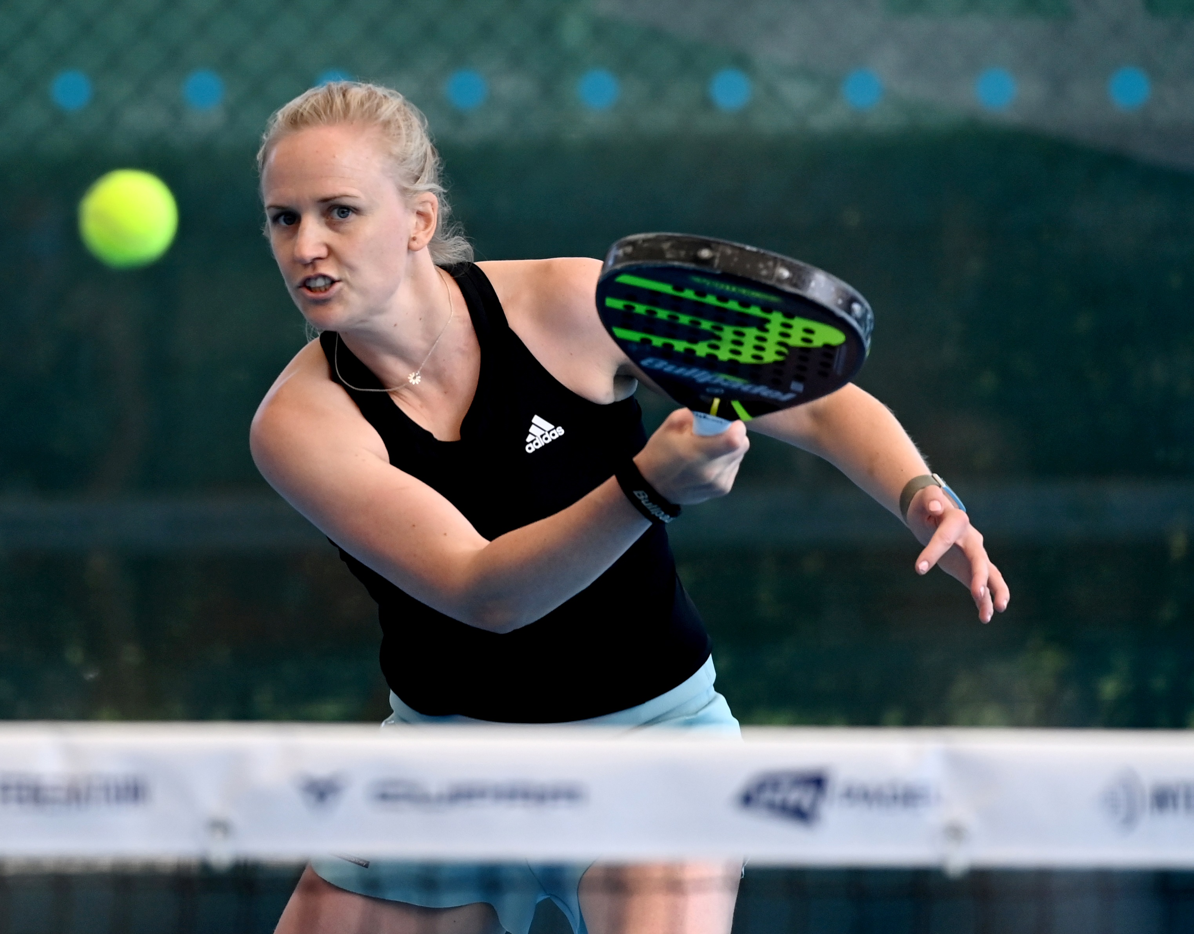
Personal statement
This is where you can really show us your passion for becoming an LTA Padel Instructor and demonstrate your padel knowledge. Please refer to the video in the task for support and guidance. Speak clearly into the camera and wear appropriate coaching attire - you should also be filming your video in a coaching environment (such as a the padel venue you are based at).
Please answer the 3 questions below in no more than 3 minutes total.
Describe what you’ve learned about padel tactics since taking up the sport.
Describe your motivation for applying for the LTA Padel Instructor and how you will use the qualification once you’ve graduated.
What makes you an inspirational character who engages people to learn and play padel?

Slide 7
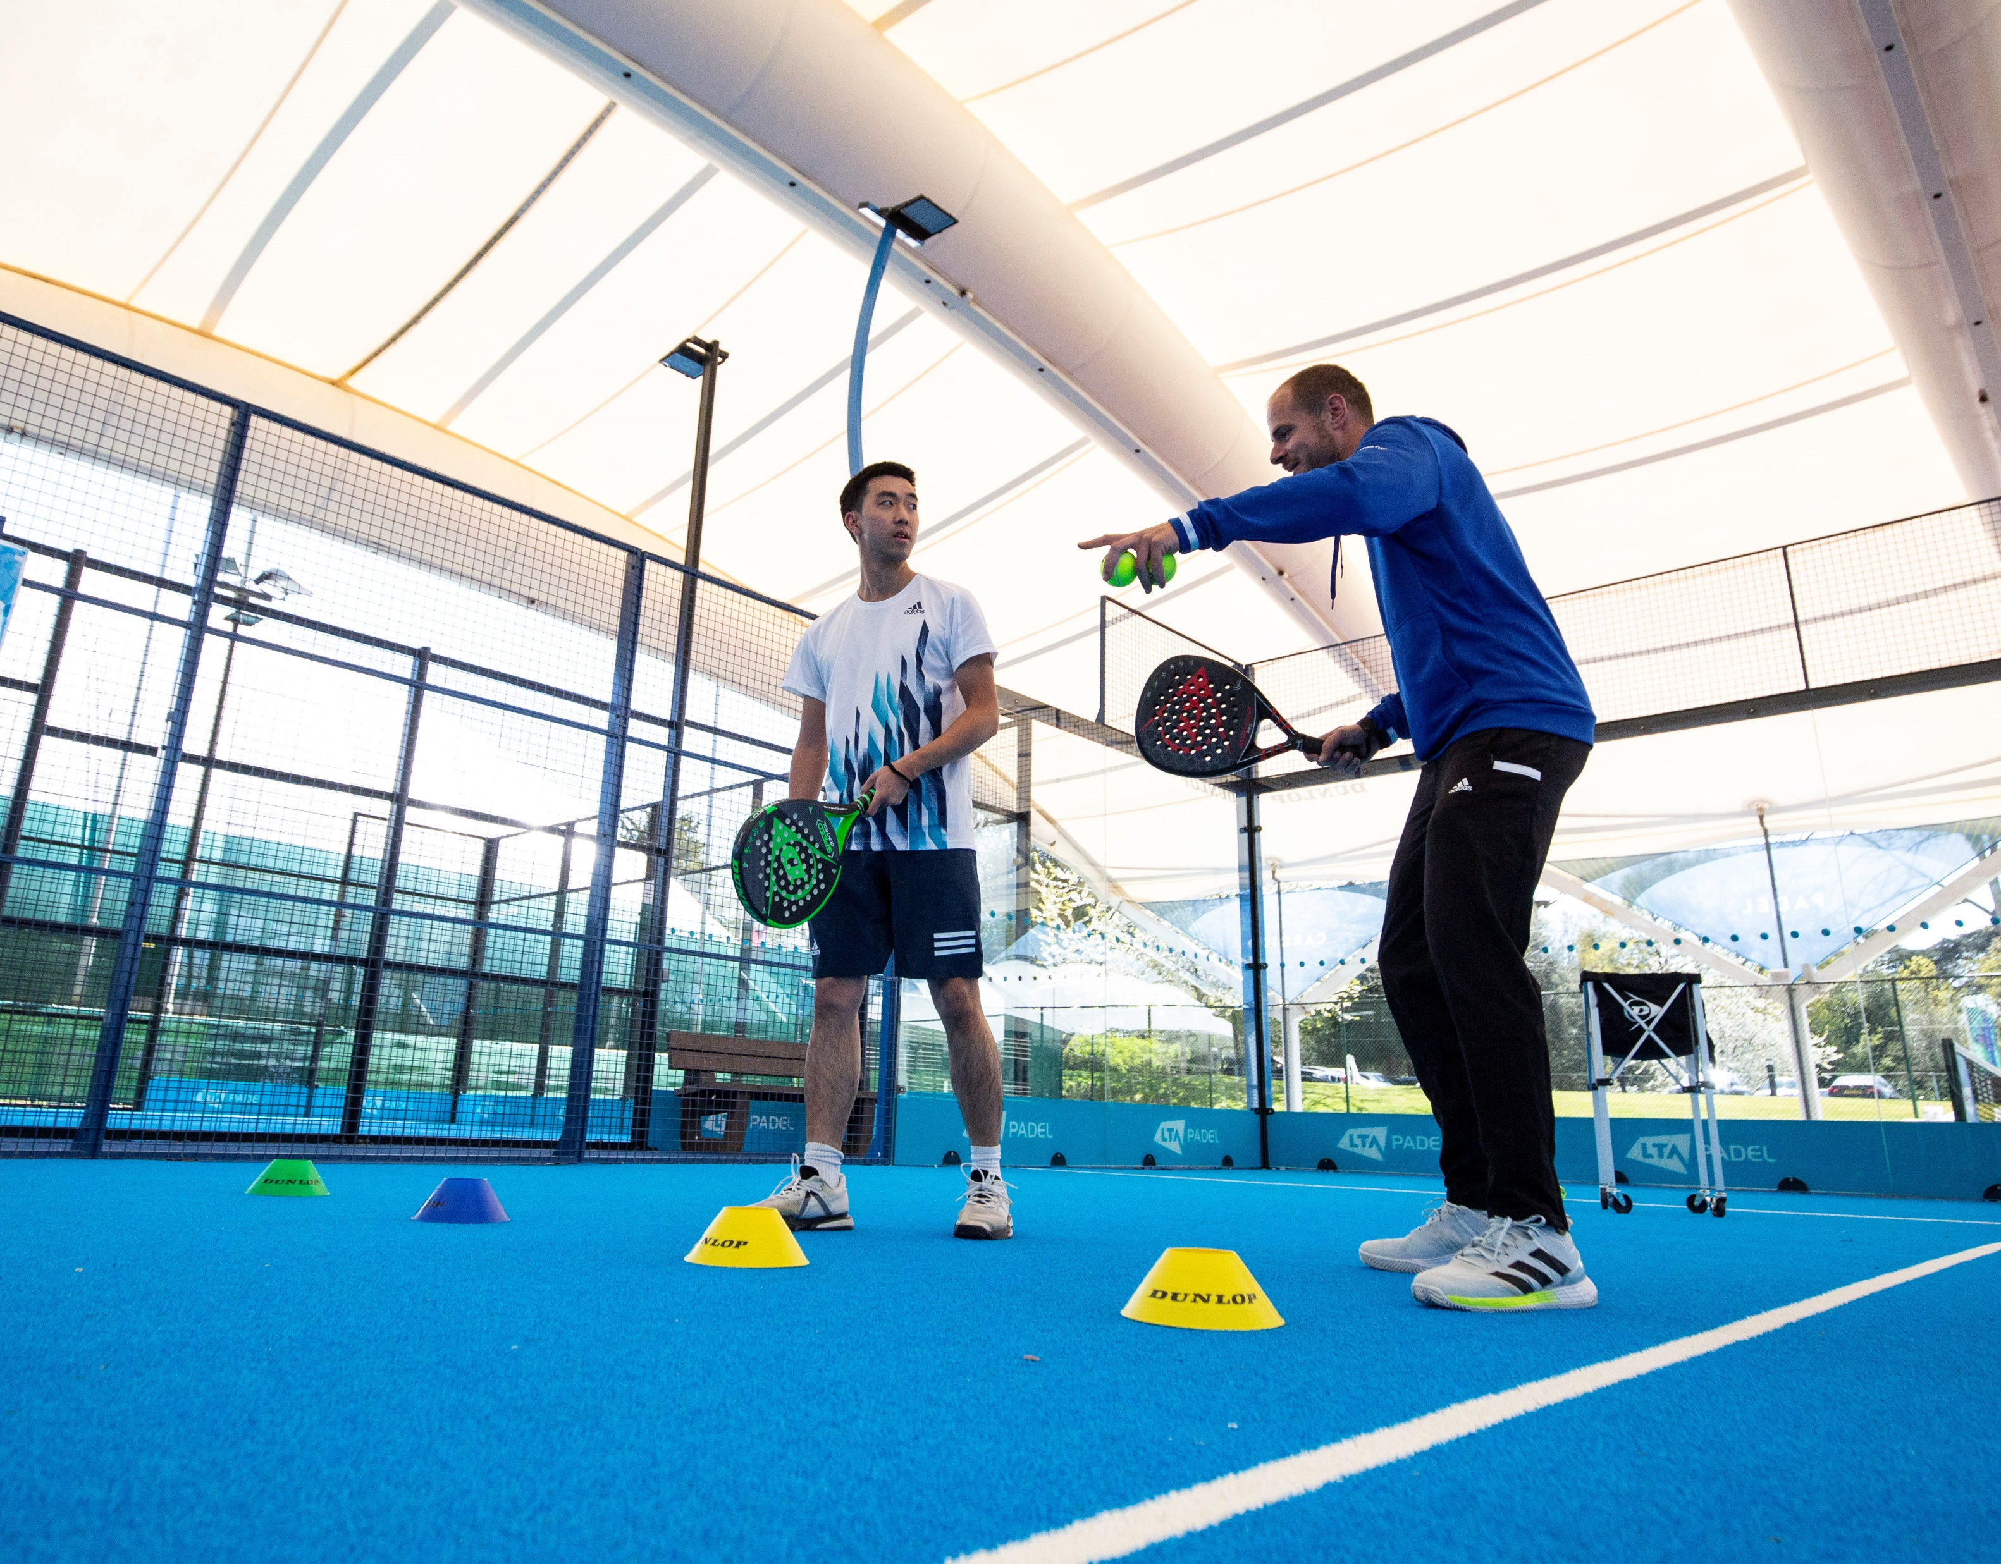
Demonstration Task
The demonstration task is your chance to show a demo of a topic. You have 3 choices:
Topic 1: Taking the net
Game situation: Opponent at net
Tactic: Controlling space by taking the net
Technical: How should they hit the ball?
Topic 2: Neutralising after the lob
Game situation: When players have been lobbed
Tactic: Controlling time
Technical: How should they hit the ball?
Topic 3: The return of serve
Game situation: When returning the serve
Tactic: Consistency
Technical: How should they hit the ball?
Demonstrations should be 2 minutes long and be pitched at intermediate players.

Slide 8
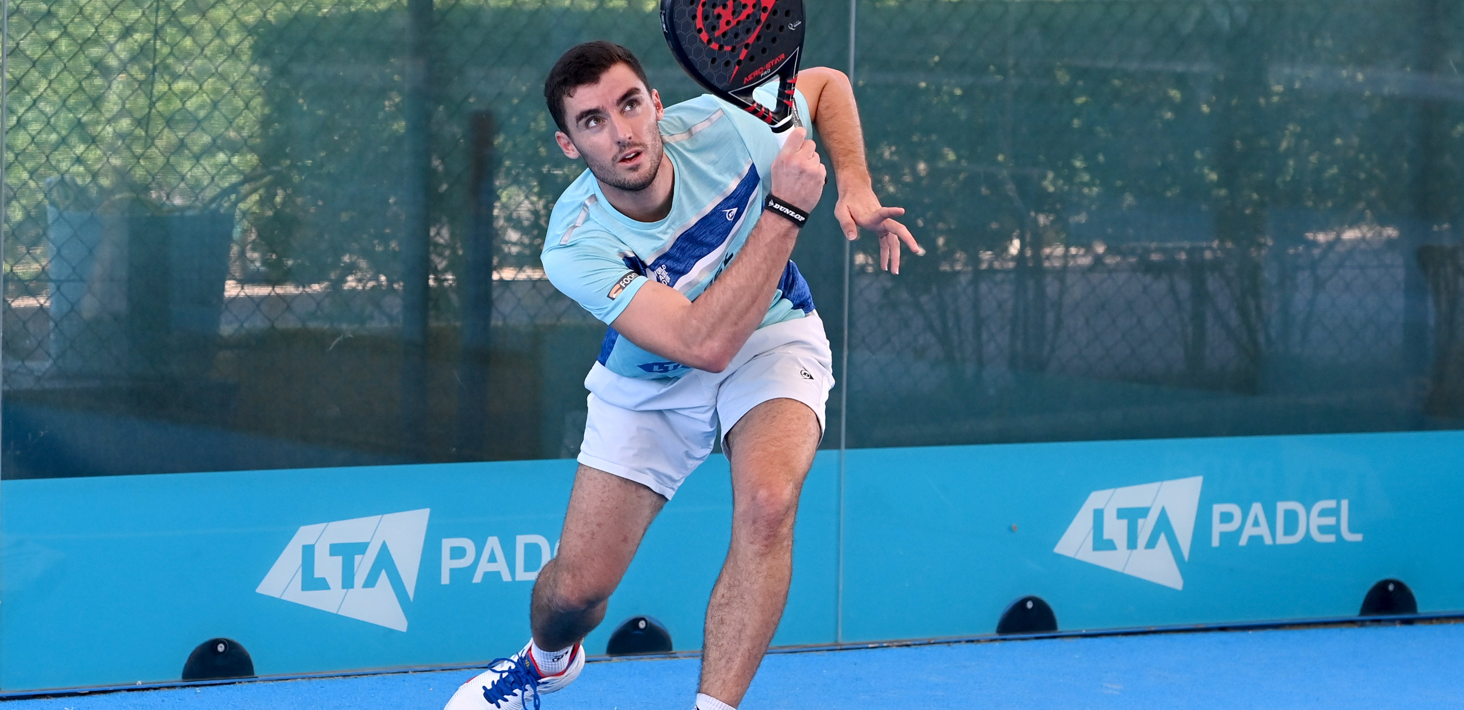
Lob feeding task
You must show 5 successful lob feeds in a row.
Stand behind the baseline and lob down the line.
Each lob must:
be hit higher than the highest part of the court (4 metres)
land past the service line
rebound on to the top half of the glass
have a second bounce that stays behind the service line.
Role modelling a good athletic stance and having your basket in the right place are important.
Notes:
Proper Angle – https://youtu.be/8DMeS66NaGk
Front Angle - https://youtu.be/EypdQ-b5NSE
Serve and volley - https://youtu.be/BSTkHa5og8E

Slide 9
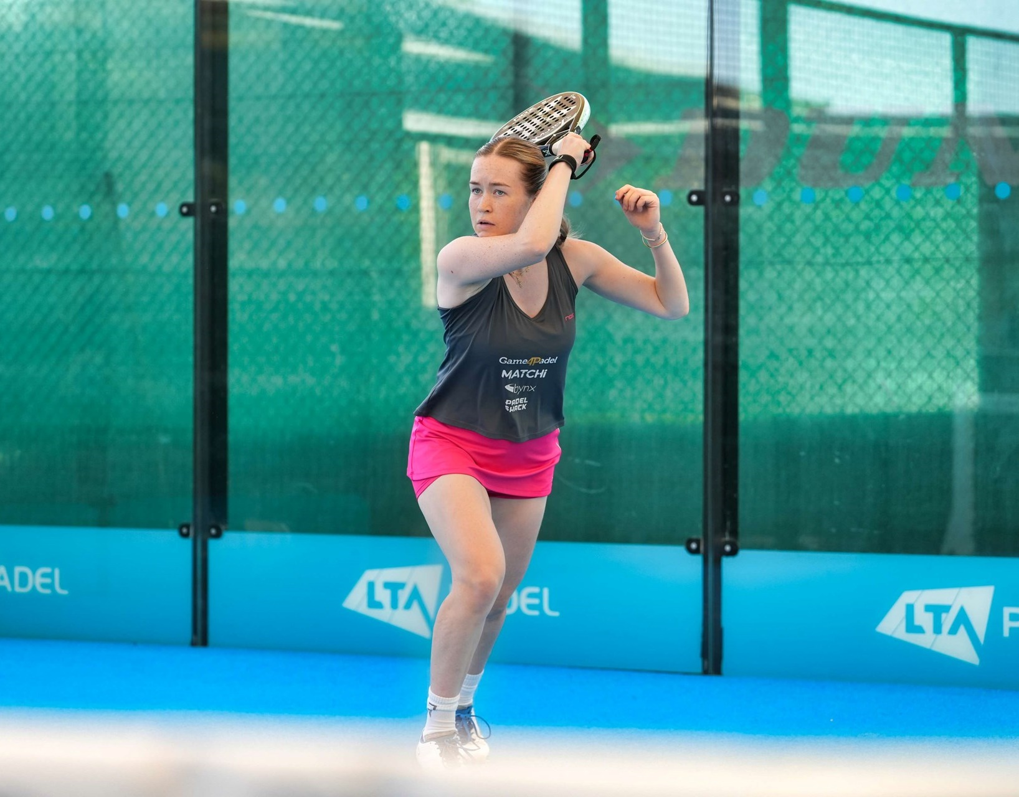
Tactics:
First chance to take the net
Players always serve and volley
Force opponents to hit neutral or defensive shots
Serve task
Technique:
Drop the ball to the side from shoulder height and behind the service line
Racket take back should be high
Swing down through the ball with an open racket face in continental grip, hitting at waist height
Impart slice on the ball to keep it low off the glass
Show movement through the serve (towards the net)
Task:
Hit 8 serves from the right and 8 from the left that hit the 1st side panel after the bounce.
8 out of 16 to pass the test

Slide 10
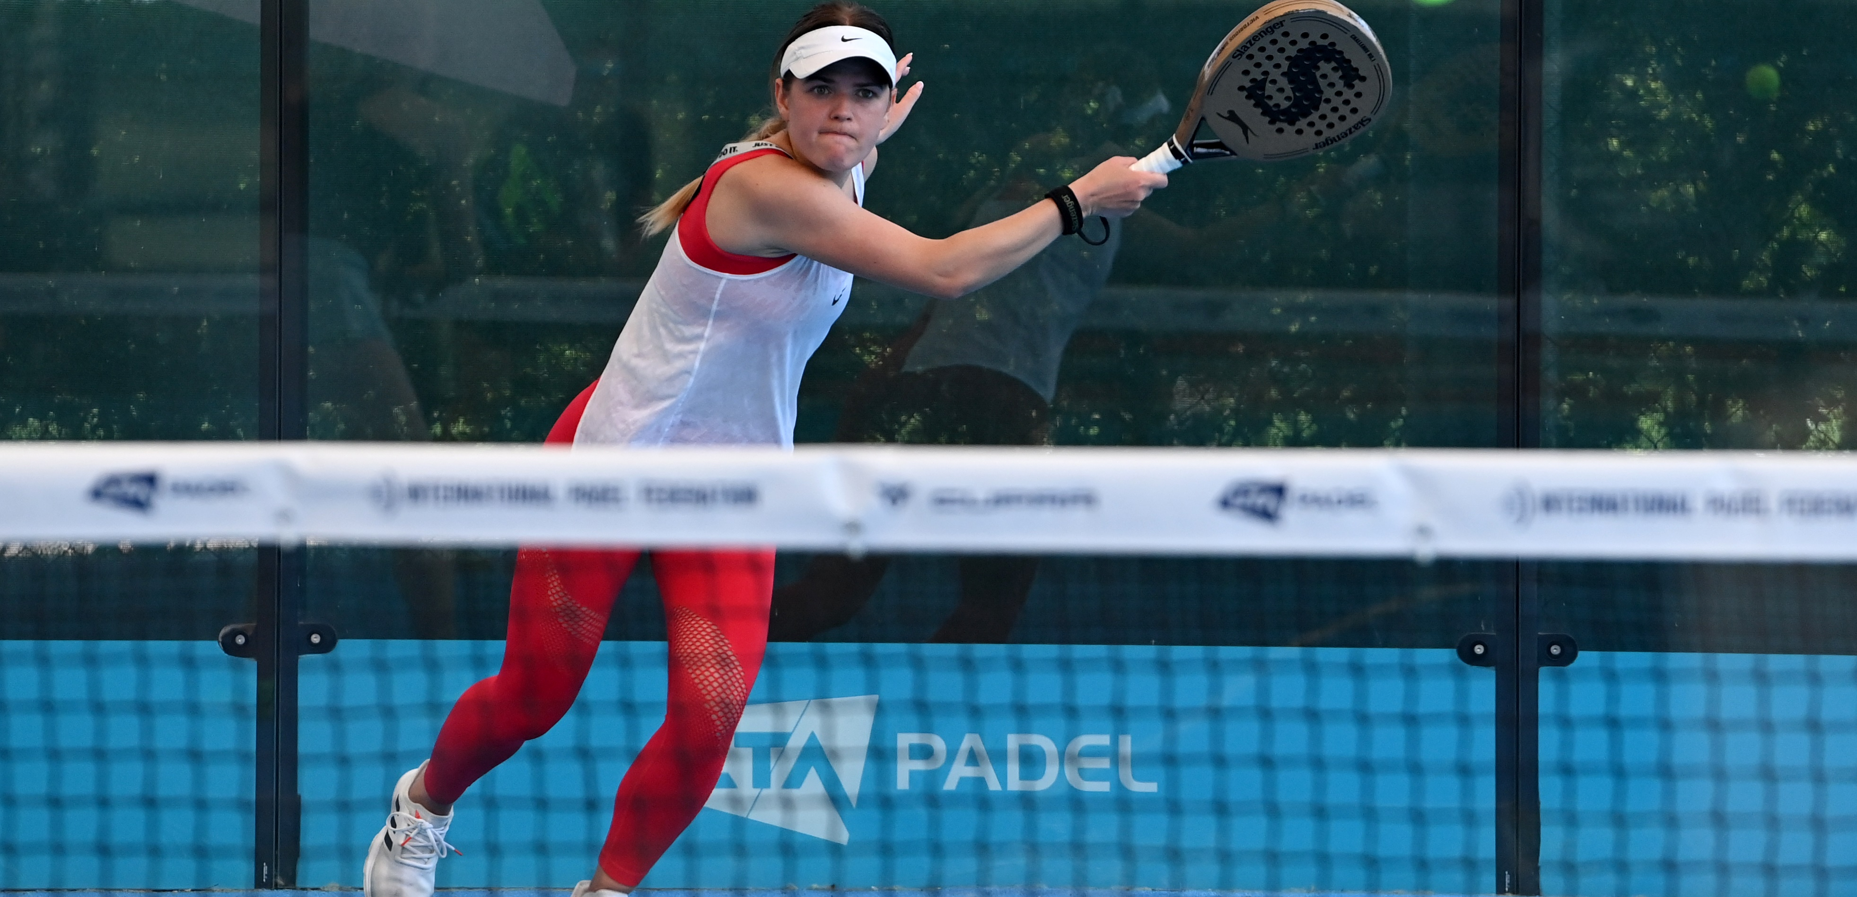
Serve:
right court
Outcome:
8 balls to the RIGHT court – a total of 8 out of 16 across both sides to pass this task.
Process: show ‘good’ padel technique as referred to in the previous slide.
This video shows right court serves filmed from the correct angle for a readiness test.
Notes:
Proper Angle – https://youtu.be/8DMeS66NaGk
Front Angle - https://youtu.be/EypdQ-b5NSE
Serve and volley - https://youtu.be/BSTkHa5og8E

Slide 11
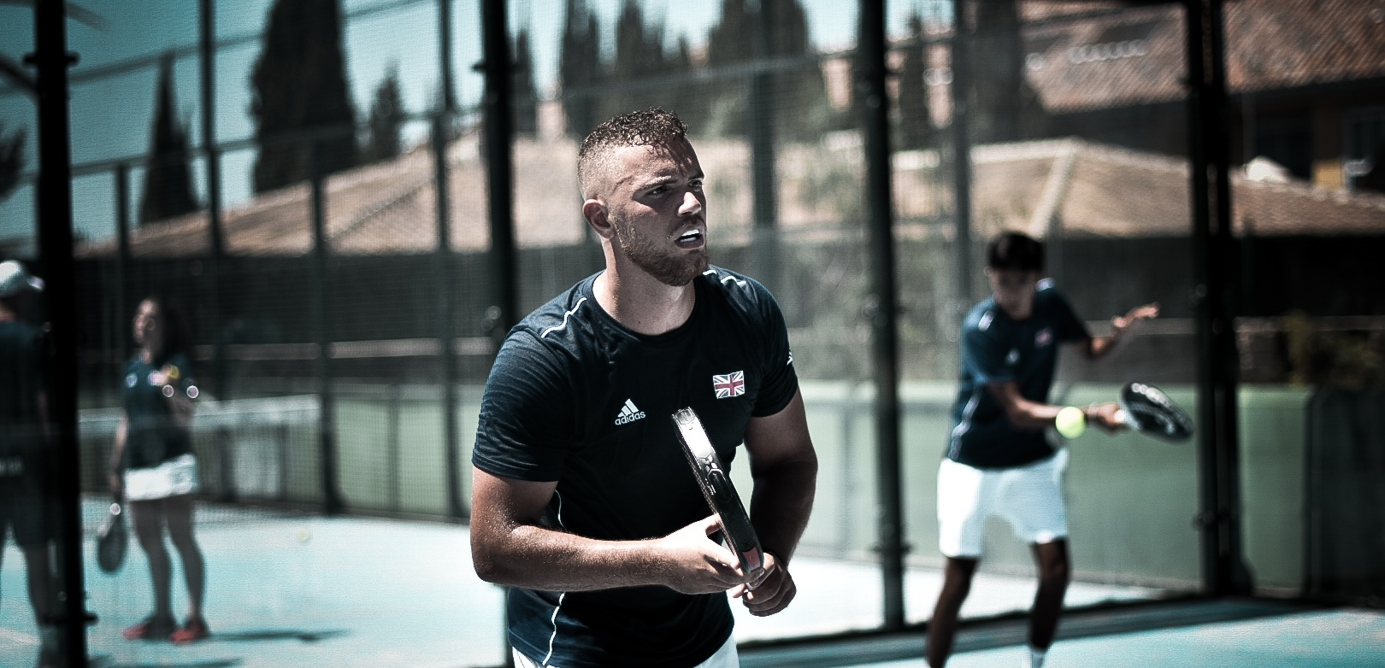
Serve:
Left court
Outcome:
8 balls to the LEFT court – a total of 8 out of 16 across both sides to pass this task.
Process: show ‘good’ padel technique as referred to in the previous slide.
This video shows left court serves filmed from the correct angle for a readiness test.
Notes:
Proper angle - https://youtu.be/JEYI4Pcm2J8

Slide 12
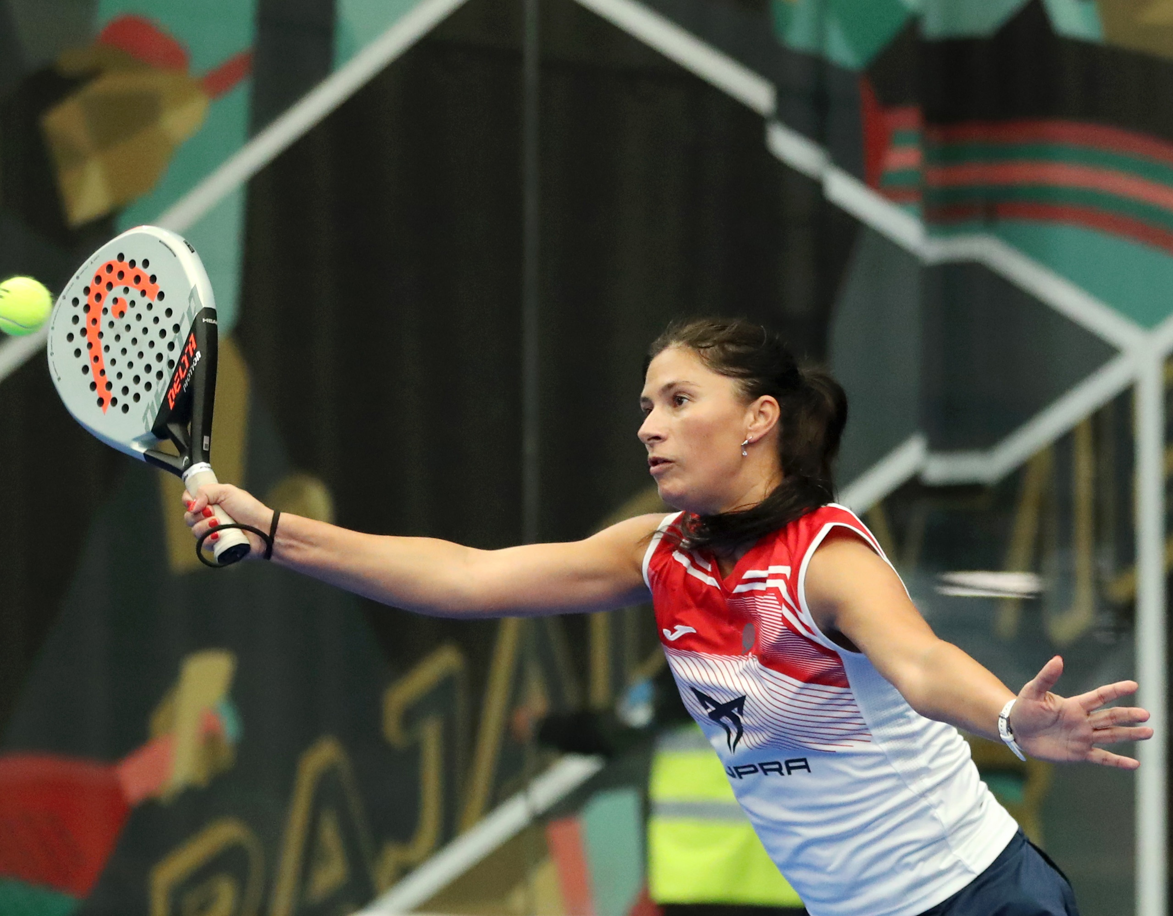
Volley task
Tactics:
Objective is to maintain the net
Keep volleys low
Force opponents to hit neutral or defensive shots
Technique:
Players use backspin or slice to keep the ball low and make the ball bounce down off the glass
This involves a path that is high to low and an open racket face
Padel volleys generally have a longer swing path than tennis volleys
Task:
Using only 1 ball, hit 15 volleys past the service line in 1 minute. At least 6 volleys must be backhands.

Slide 13
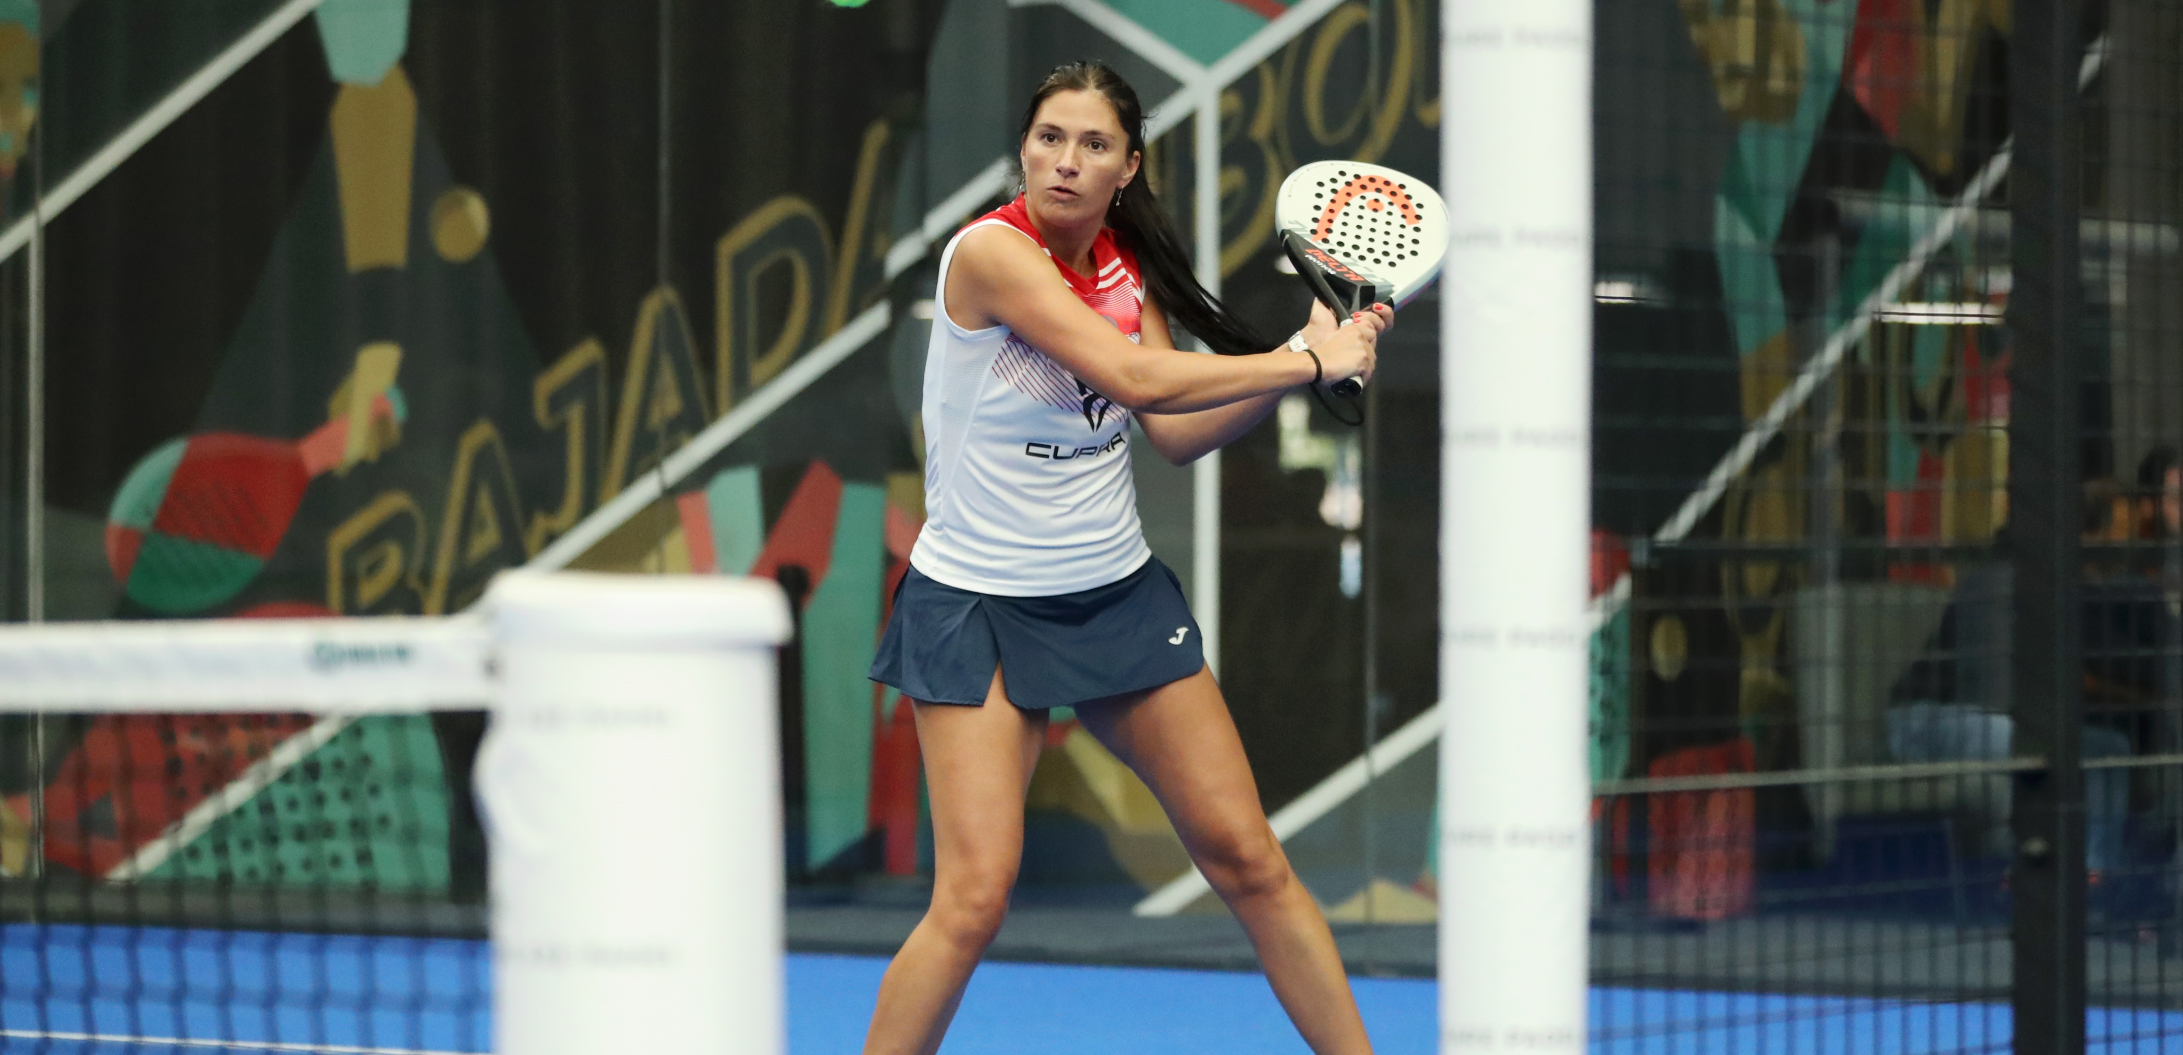
volleys
Outcome:
15 balls in one minute that land past the service line. At least 6 must be scoring backhands.
Process:
Show ‘good’ padel volley technique with consistent contact point generating slice on the ball.
Only one ball is allowed for the volley exercise. That same ball must be used throughout the exercise.
The baseline player must let the ball bounce for the volley to be counted.
No editing of the video is allowed.
Notes:
Link for proper video – https://youtu.be/NDqMywFWJ9o
Link for front angle - https://youtu.be/BTsLUea_oCY

Slide 14
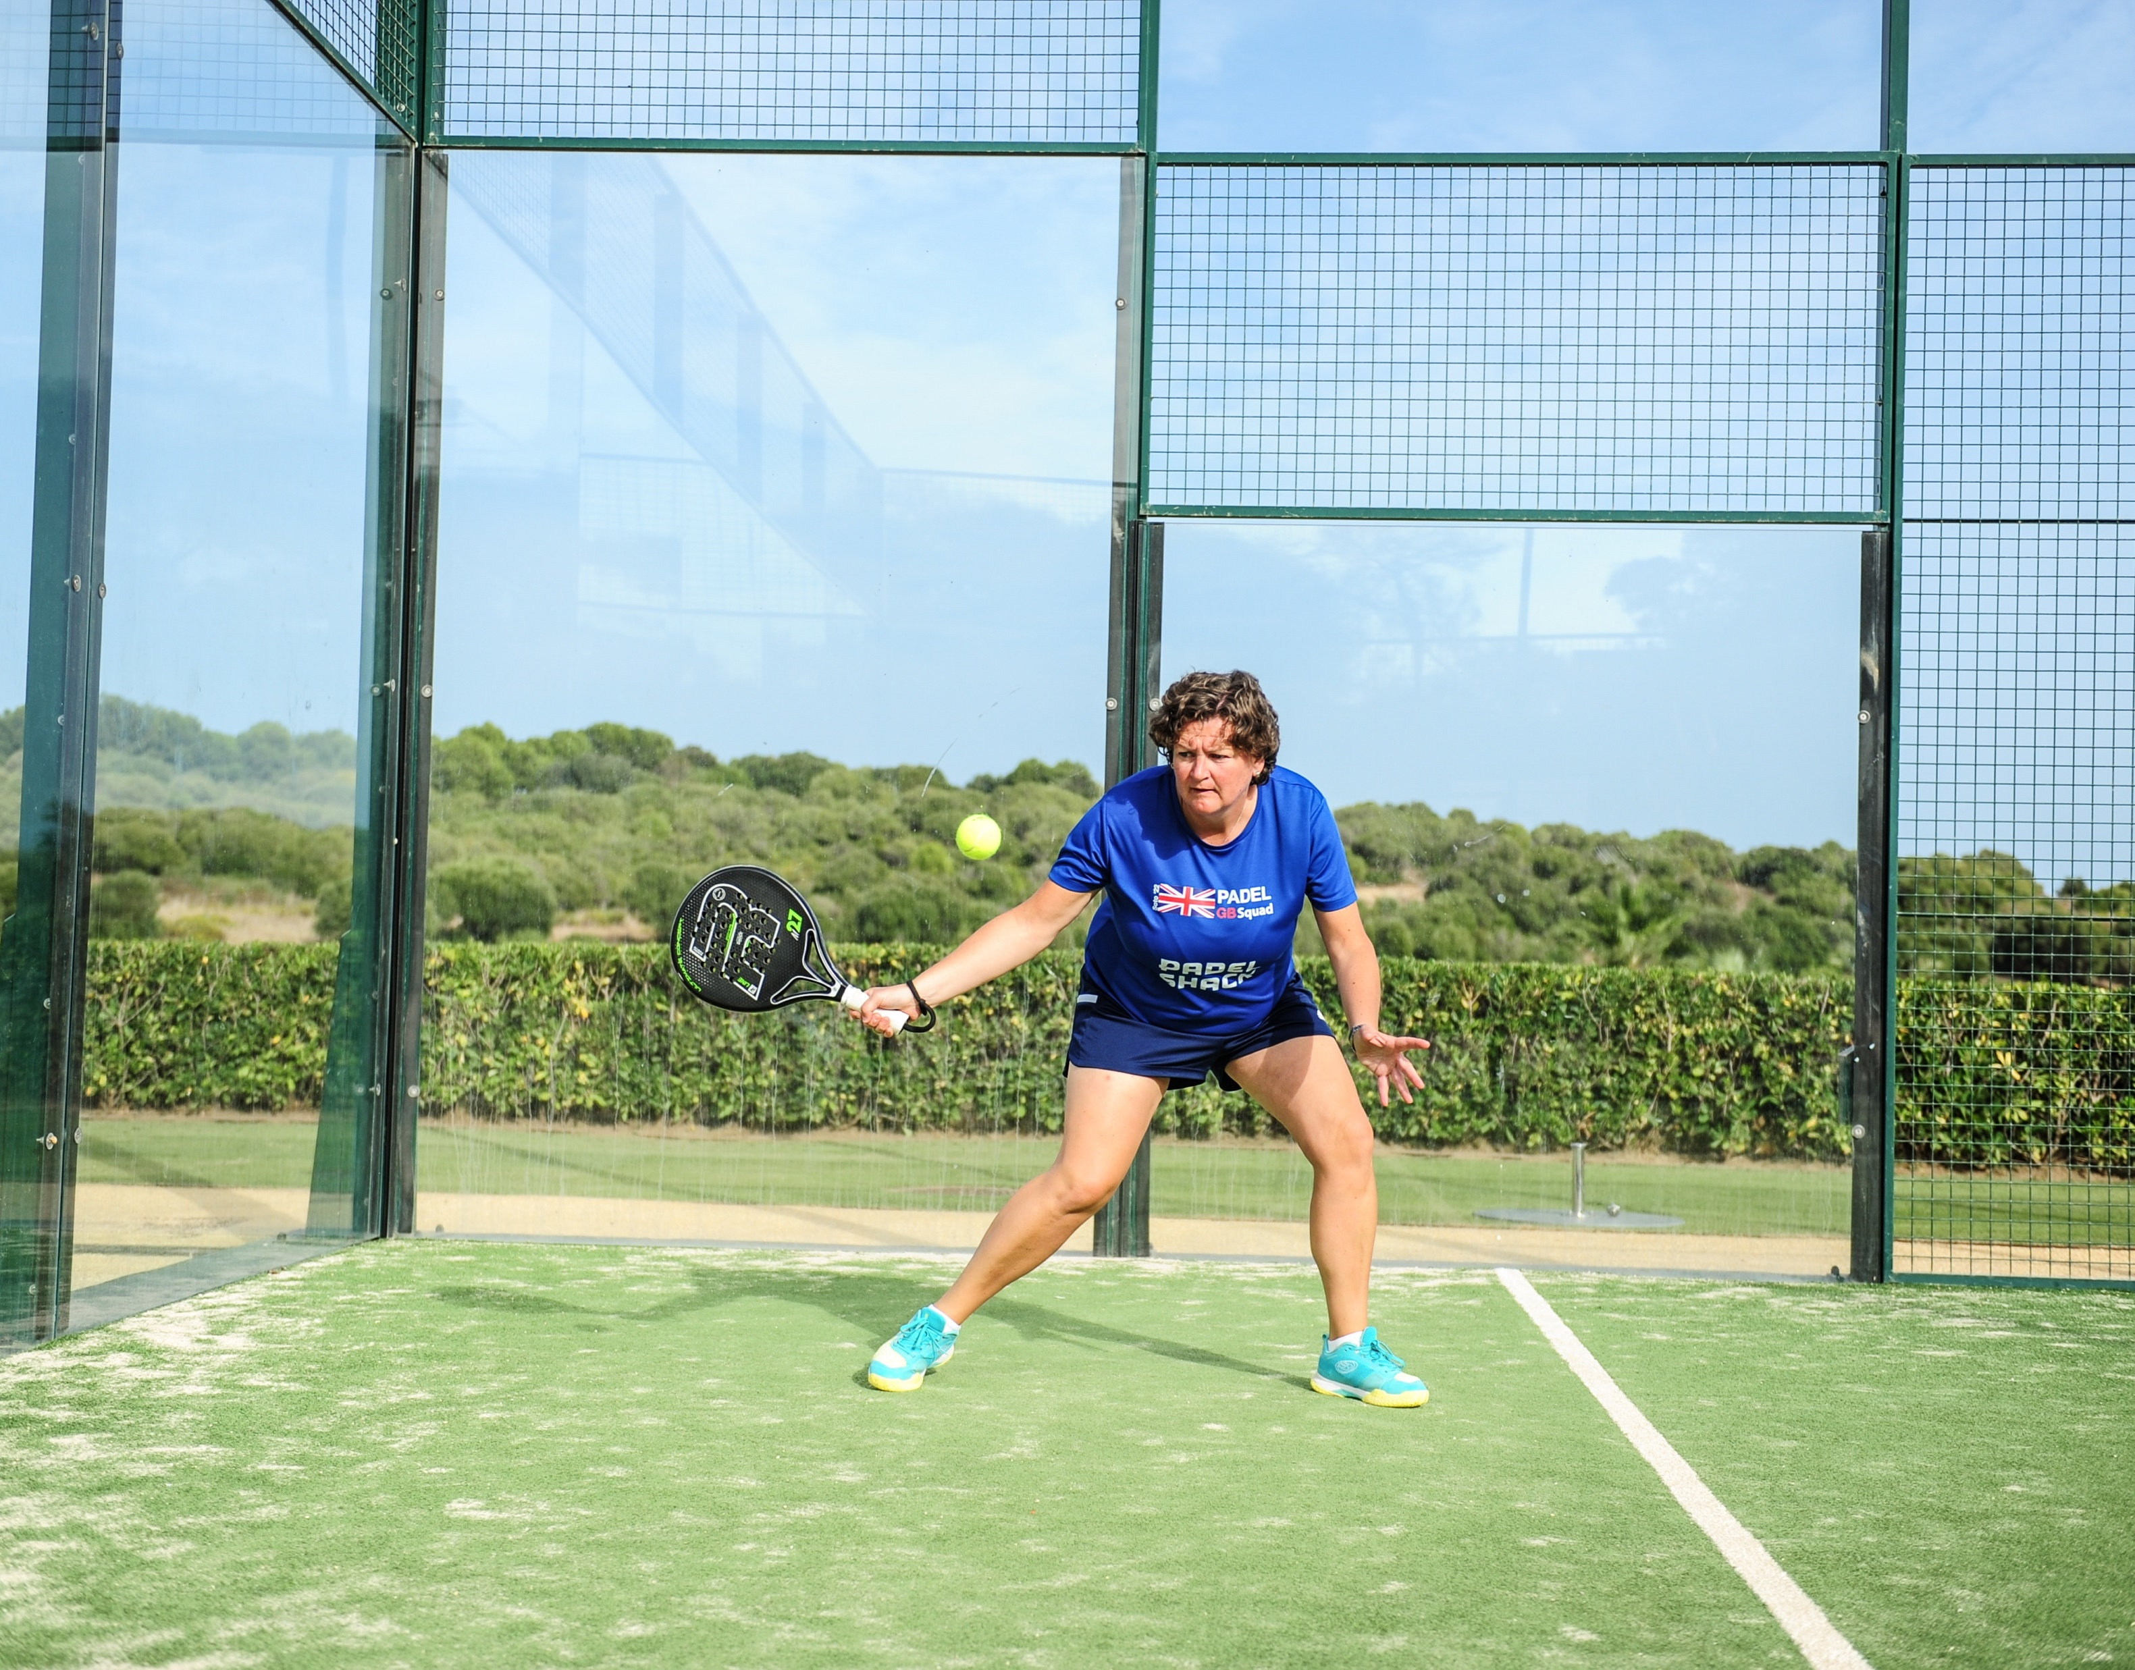
Tactics:
Defend the baseline
Slow down the play by using the glass
Use lobs and chiquitas to take the net
Groundstrokes task
Technique:
Racket preparation should be early, and swings are compact to enable success off the glass
Contact is in front of the shoes
Task:
Using only 1 ball, hit 15 balls from the baseline in 1 minute, with least 6 shots in which you use the back glass.

Slide 15
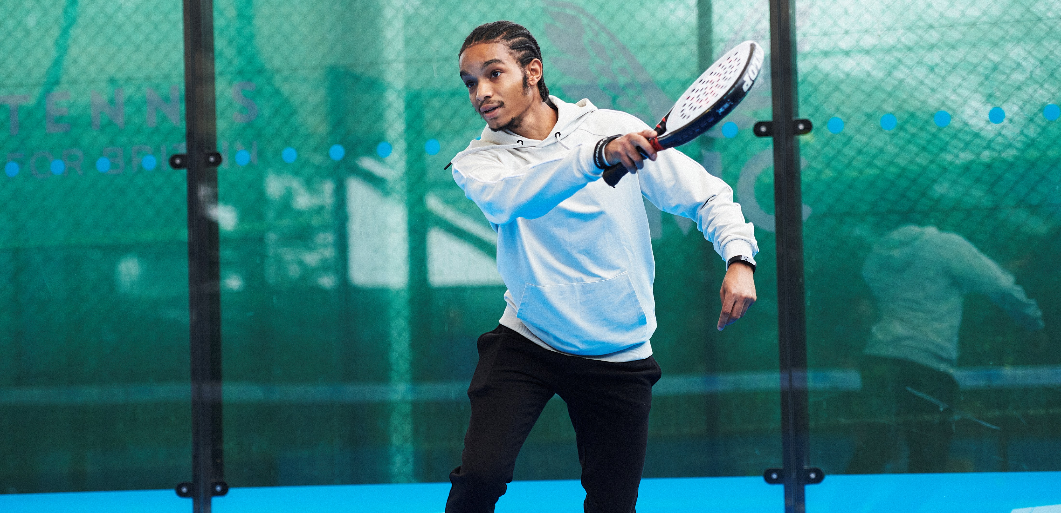
Groundstrokes
Right court
Outcome:
15 balls hit in one minute, with at least 6 hit using the rebound off the back glass. Only 1 ball can be used for this task.
Process:
Show ‘good’ padel groundstroke technique with a compact backswing and contact point in front of the shoes.
This video shows right court groundstrokes filmed from the correct angle for a Readiness Test.
Notes:
Proper angle - https://youtu.be/1giIup2p394
Side angle - https://youtu.be/vumKt4Sv2eA

Slide 16
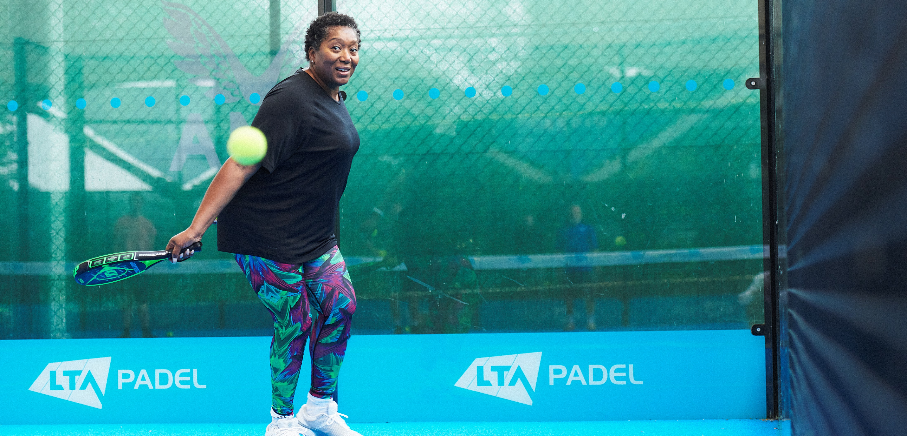
Groundstroke left court
Outcome:
15 balls hit in one minute, with at least 6 hit using the rebound off the back glass. Only 1 ball can be used for this task.
Process:
Show ‘good’ padel groundstroke technique with a compact backswing and contact point in front of the shoes.
This video shows left court groundstrokes filmed from the correct angle for a Readiness Test.
Notes:
Proper Angle - https://youtu.be/w8dnUAbmGOg
Side angle - https://youtu.be/w8dnUAbmGOg

Slide 17
THANKS, AND GOOD LUCK ON YOUR READINESS TEST

